Slide 1
CLUSTERING
DONE BY,
B.N.Faheen Fathima [15euit030]
S.Divya Bharathi [15euit028]
G.Dharani [15euit024]
Hindhu Sreeni [15euit040]

Slide 2
INTRODUCTION
UNSUPERVISED LEARNING
Clustering is the task of dividing the population or data points into a number of groups such that data points in the same groups are more similar to other data points in the same group than those in other groups.

Slide 3
CLASSIFICATION OF CLUSTERING
Exclusive Clustering
Overlapping Clustering
Hierarchical Clustering
Probabilistic Clustering

Slide 4
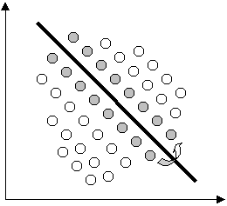
EXCLUSIVE CLUSTERING
If a certain datum belongs to a definite cluster then it could not be included in another cluster.
Example: K-means

Slide 5
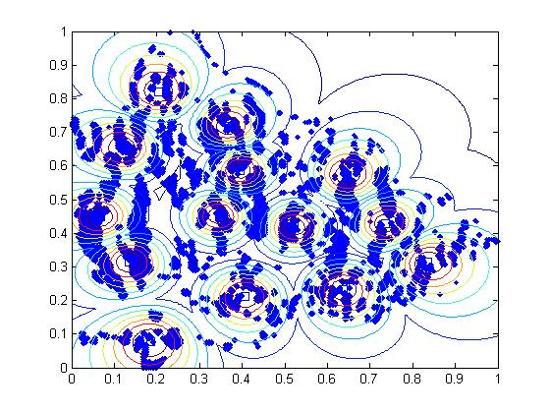
OVERLAPPING
If a certain datum belongs to a definite cluster then it could not be included in another cluster.
Example: Fuzzy C-means

Slide 6
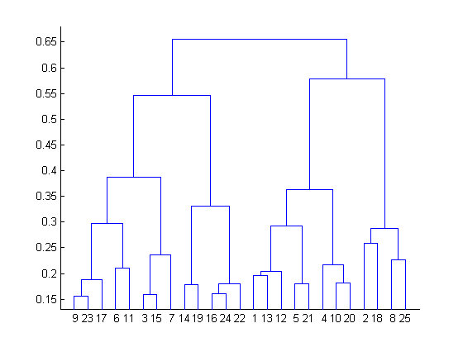
HIERARCHIAL CLUSTERING
A hierarchical clustering algorithm is based on the union between the two nearest clusters. The beginning condition is realized by setting every datum as a cluster(unsupervised). After a few iterations it reaches the final clusters wanted.
Example: Hierarchial clustering

Slide 7
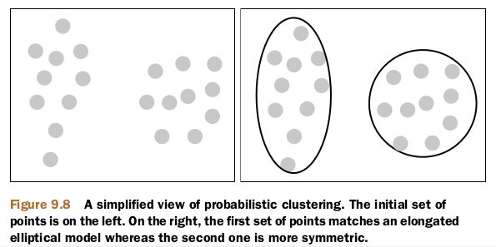
PROBABILISTIC CLUSTERING
The datum is classified using a completely probabilistic method. It includes calculating probability of the data and clustering it with close probability
Example : Mixture of Gaussian

Slide 8
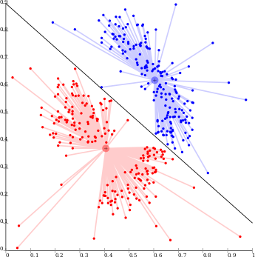
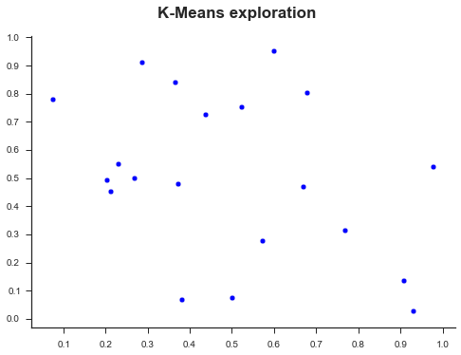
COMPARING K-MEANS AND FUZZY C MEANS

Slide 9
APPLICATIONS
Recommendation engines
Market segmentation
Social network analysis
Search result grouping
Medical imaging
Image segmentation
Anomaly detection

Slide 10
THANK YOU!

